Slide 1

Zoom meeting ID
Calendar URL: https://bit.ly/3aYQRkg
Please subscribe to this URL now!
To save bandwidth
Turn off your camera
Mute your microphone
Use campuswire for questions

Slide 2

Course discussion/Q&A
URL: https://campuswire.com/p/GFADD516B
Code: 9109
Please join now!
Q&A using chatrooms

Slide 3
Course Assistants
Sreyas Mohan
PhD student at NYU Center for Data Science
Phu Mon Htut
PhD student at NYU Center for Data Science
Sean Welleck
PhD student at NYU Computer Science

Slide 4
Recap: Supervised Machine Learning
You all know already, but it’s important enough to warrant repetition.

Slide 5
Supervised Learning – Overview
Provided:
a set of N input-output “training” examples
A per-example loss function⭑
Evaluation sets*: validation and test examples
What we must decide:
Hypothesis sets
Each set consists of all compatible models
Optimization algorithm
⭑ Often it is necessary to design a loss function.
* Often these sets are created by holding out subsets of training examples.

Slide 6
Supervised Learning – Overview
Given:
and
Optimization algorithm
Supervised learning finds an appropriate algorithm/model automatically
For each hypothesis set , find the best model: using the optimization algorithm.

Slide 7
Supervised Learning – Overview
Given:
and
Optimization algorithm
Supervised learning finds an appropriate algorithm/model automatically
[Training] For each hypothesis set , find the best model: using the optimization algorithm and the training set.

Slide 8
Supervised Learning – Overview
Given:
and
Optimization algorithm
Supervised learning finds an appropriate algorithm/model automatically
[Model Selection]* Among the trained models, select the best one using the validation set loss.
* If you’re familiar with deep learning, “hyperparameter optimization” may be a more familiar term for you.

Slide 9
Supervised Learning – Overview
Given:
and
Optimization algorithm
Supervised learning finds an appropriate algorithm/model automatically
[Reporting] Report how well the best model would work using the test set loss.
* If you’re familiar with deep learning, “hyperparameter optimization” may be a more familiar term for you.

Slide 10
Supervised Learning – Overview
Given:
and
Optimization algorithm
Supervised learning finds an appropriate algorithm/model automatically
It results in an algorithm with an expected performance of .

Slide 11
Supervised Learning
Three points to consider both in research and in practice
How do we decide/design a hypothesis set?
How do we decide a loss function?
How do we optimize the loss function?

Slide 12
Hypothesis set – Neural Networks
What kind of machine learning approach will we consider?
Classification:
Support vector machines, Naïve Bayes classifier, logistic regression, …?
Regression:
Support vector regression, Linear regression, Gaussian process, …?
How are the hyperparameters sets?
Support vector machines: regularization coefficient
Gaussian process: kernel function

Slide 13
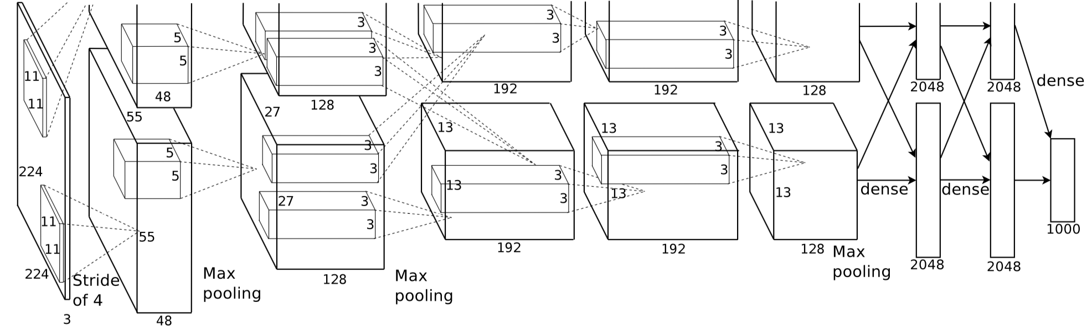
Hypothesis set – Neural Networks
In the case of deep learning/artificial neural networks,
The architecture of a network defines a set
Each model in the set is characterized by its parameters
Weights and bias vectors define one model in the hypothesis set.
There are infinitely many models in a hypothesis set.
We use optimization to find “a” good model from the hypothesis set.
vs.

Slide 14
Network Architectures
What is a neural network? – An (arbitrary) directed acyclic graph (DAG)
Solid Circles : parameters (to be estimated or found)
Dashed Circles : vector inputs/outputs (given as a training example)
Squares : compute nodes (functions, often continuous/differentiable)

Slide 15
Network Architectures
What is a neural network? – An (arbitrary) directed acyclic graph (DAG)
Logistic regression
3rd-order polynomial function

Slide 16
Inference – Forward Computation
What is a neural network? – An (arbitrary) directed acyclic graph (DAG)
Forward computation: how you “use” a trained neural network.
Topological sweep (breadth-first)
Logistic regression

Slide 17
DAG ↔ Hypothesis Set
What is a neural network? – An (arbitrary) directed acyclic graph (DAG)
Implication in practice
Naturally supports high-level abstraction
Object-oriented paradigm fits well.*
Base classes: variable (input/output) node, operation node
Define the internal various types of variables and operations by inheritance
Maximal code reusability
See the success of PyTorch, TensorFlow, DyNet, …
You define a hypothesis set by designing a directed acyclic graph.
The hypothesis space is then a set of all possible parameter settings.
* Functional programming as well ☺

Slide 18
Supervised Learning
Three points to consider both in research and in practice
How do we decide/design a hypothesis set?
How do we decide a loss function?
How do we optimize the loss function?

Slide 19
Loss Functions
Per-example loss function
Computes how good a model is doing on a given example:
So many loss functions…
Classification: hinge loss, log-loss, …
Regression: mean squared error, mean absolute error, robust loss, …
In this lecture, we stick to distribution-based loss functions.

Slide 20
A Neural network computes a conditional distribution
Supervised learning: what is y given x ?
In other words, how probable is a certain value y’ of y given x?
What kind of distributions?
Binary classification: Bernoulli distribution
Multiclass classification: Categorical distribution
Linear regression: Gaussian distribution
Multimodal linear regression: Mixture of Gaussians

Slide 21
Important distributions – Categorical
How probable is a certain value y’ of y given x?
Multi-class classification: Categorical distribution
Probability: , where
Fully characterized by .
A neural network then should turn the input into a vector using a softmax function: .
An arbitrary
sub-graph

Slide 22
Important distributions – Gaussian
How probable is a certain value y’ of y given x?
Regression: Gaussian distribution with an identity covariance
Probability:
Fully characterized by .
A neural network then should turn the input into a vector .
Can be done trivially by affine transformation.

Slide 23
Loss Function – negative log-probability
Once a neural network outputs a conditional distribution , a natural way to define a loss function arises.
Make sure training data is maximally likely:
Equiv. to making sure each and every training example is maximally likely.
Why log? – many reasons… but out of the lecture’s scope.
Equivalently, we want to minimize the negative log-probability.
A loss function is the sum of negative log-probabilities of correct answers.

Slide 24
Loss Function – negative log-probability
Once a neural network outputs a conditional distribution , a natural way to define a loss function arises.
Practical implications
An OP node: negative log-probability (e.g., NLLLoss in PyTorch)
Inputs: the conditional distribution and the correct output
Output: the negative log-probability (a scalar)

Slide 25
Loss Function – negative log-probability
Once a neural network outputs a conditional distribution , a natural way to define a loss function arises.
Logistic regression
Computes a Bernoulli distribution
Computes a negative log-probability
All in one directed acyclic graph
Forward computation
Computes the conditional distribution, and
Computes the per-example loss
NLLLoss

Slide 26
Supervised Learning
Three points to consider both in research and in practice
How do we decide/design a hypothesis set?
How do we decide a loss function?
How do we optimize the loss function?

Slide 27
Loss Minimization
What we now know
How to build a neural network with an arbitrary architecture.
How to define a per-example loss as a negative log-probability.
Define a single directed acyclic graph containing both.
What we now need to know
Choose an optimization algorithm.
How to use the optimization algorithm to estimate parameters .

Slide 28
Gradient-based optimization
A continuous, differentiable* function
Given the current value , how should I move to minimize ?
Gradient descent
The negative gradient of the function:
This is only valid in a local neighbourhood of : take a very small step!
Efficient and effective even in the high dimensional space.
Can be improved with the second-order information (Hessian and/or FIM)
* Almost everywhere, but not necessarily everywhere

Slide 29
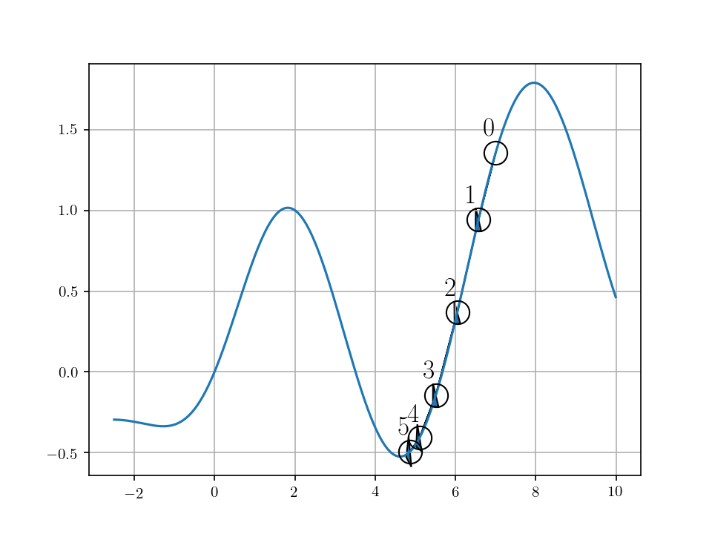
Gradient-based optimization
A continuous, differentiable function
Given the current value , how should I move to minimize ?
Gradient descent
Efficient and effective even in the high dimensional space.
Learning rate must be carefully selected and annealed over time.

Slide 30
Backward Computation – Backpropagation
How do we compute the gradient of the loss function?
Manual derivation
Relatively doable when the DAG is small and simple.
When the DAG is larger and complicated, too much hassle.
Automatic differentiation (autograd)
Use the chain rule of derivatives
The DAG is nothing but a composition of (mostly) differentiable functions.
Automatically apply the chain rule of derivatives.

Slide 31
Backward Computation – Backpropagation
Automatic differentiation (autograd)
Implement the Jacobian-vector product of each OP node:
Can be implemented efficiently without explicitly computing the Jacobian.
The same implementation can be reused every time the OP node is called.

Slide 32
Backward Computation – Backpropagation
Automatic differentiation (autograd)
Reverse-sweep the DAG starting from the loss function node.
Iteratively multiplies the Jacobian of each OP node until the leaf nodes of the parameters.
As expensive as forward computation with a constant overhead: O(N), where N: # of nodes.
NLLLoss

Slide 33
Backward Computation – Backpropagation
Practical Implications – Automatic differentiation (autograd)
Unless a complete new OP is introduced, no need to manually derive the gradient
Nice de-coupling of specification (front-end) and implementation (back-end)
[Front-end] Design a neural network by creating a DAG.
[Back-end] The DAG is “compiled” into an efficient code for a target compute device.
GPU
GPU
CPU
Compilation
CPU
CPU
CPU
Compute Backend
DAG

Slide 34
Gradient-based Optimization
Backpropagation gives us the gradient of the loss function w.r.t.
Readily used by off-the-shelf gradient-based optimizers
Gradient descent, L-BFGS, Conjugate gradient, …
Though, most are not applicable in a realistic neural network with 10s or 100s of millions of parameters.
Stochastic gradient descent
Approximate the full loss function (the sum of per-examples losses) using only a small random subset of training examples:

Slide 35
Stochastic Gradient Descent
Stochastic gradient descent
Approximate the full loss function (the sum of per-examples losses) using only a small random subset of training examples:
Unbiased estimate of the full gradient.*
Learning rate must be annealed appropriately.
Extremely efficient de facto standard practice.
* Under certain conditions

Slide 36
Stochastic Gradient Descent
Stochastic gradient descent in practice
Grab a random subset of M training examples*
Compute the minibatch gradient
Update the parameters
Repeat until the validation loss stops improving.⭑
* In practice, sample without replacement until the training set is exhausted (one epoch).
⭑ This is called early-stopping which prevents the neural network from overfitting to training examples.

Slide 37
Stochastic Gradient Descent – Early Stopping
Stochastic gradient descent in practice
Grab a random subset of M training examples
Compute the minibatch gradient
Update the parameters
Repeat until the validation loss stops improving.
An efficient way to prevent overfitting
Overfitting: the training loss is low, but the validation loss is not.
The most serious problem in statistical machine learning.
Early-stop based on the validation loss

Slide 38
Stochastic Gradient Descent – Early Stopping
An efficient way to prevent overfitting
Overfitting: the training loss is low, but the validation loss is not.
The most serious problem in statistical machine learning.
Early-stop based on the validation loss
Hypothesis set

Slide 39
Stochastic Gradient Descent – Adaptive Learning Rate
Stochastic gradient descent in practice
Grab a random subset of M training examples
Compute the minibatch gradient
Update the per-parameter learning rate
Update the parameters
Repeat until the validation loss stops improving.
Adaptive learning rate: Adam [Kingma&Ba, 2015], Adadelta [Zeiler, 2015], and many more…
Approximately re-scale parameters to improve the conditioning of the Hessian.

Slide 40
Supervised Learning with Neural Networks
How do we decide/design a hypothesis set?
Design a network architecture as a directed acyclic graph
How do we decide a loss function?
Frame the problem as a conditional distribution modelling
The per-example loss function is a negative log-probability of a correct answer
How do we optimize the loss function?
Automatic backpropagation: no manual gradient derivation
Stochastic gradient descent with early stopping [and adaptive learning rate]

Slide 41
Language modeling as supervised learning
On the boundary between unsupervised and supervised learning

Slide 42
Language Modelling
Input: a sentence
Output: the probability of the input sentence
A language model captures the distribution over all possible sentences.
It is unsupervised learning.
We will however turn the problem into a sequence of supervised learning.

Slide 43
Autoregressive language modelling
Autoregressive sequence modelling
The distribution over the next token is based on all the previous tokens.
This equality holds exactly due to the def. of conditional distribution.
Unsupervised learning becomes a set of supervised problems.
Each conditional is a neural network classifier.
Input is all the previous tokens (a partial sentence).
Output is the distribution over all possible next tokens (classes).
It is a text classification problem.

Slide 44
Autoregressive language modelling
Autoregressive sequence modelling
The distribution over the next token is based on all the previous tokens.
Each conditional is a sentence classifier:
Table Lookup
Table Lookup
Softmax
Sentence
Representation
Extractor*
An arbitrary
sub-graph
Average
Table Lookup
* See Lecture 2.

Slide 45
Autoregressive language modelling
Autoregressive sequence modelling
Loss function: the sum of negative log-probabilities
Table Lookup
Table Lookup
Softmax
Sentence
Representation
Extractor*
An arbitrary
sub-graph
Average
Table Lookup
NLLLoss

Slide 46
Scoring a sentence
Autoregressive sequence modelling
The distribution over the next token is based on all the previous tokens.
A natural way to score a sentence:
In Korea, more than half of residents speak Korean.
“In” is a reasonable token to start a sentence.
“Korea” is pretty likely given “In”
“more” is okay token to follow “In Korea”
“than” is very likely after “In Korea, more”
“half” is also very likely after “In Korea, more than”
Sum all these scores and get the sentence score.

Slide 47
Scoring a sentence
Autoregressive sequence modelling
The distribution over the next token is based on all the previous tokens.
A natural way to score a sentence:
“In Korea, more than half of residents speak Korean.” vs. “In Korea, more than half of residents speak Finnish.”
The former is more likely (=higher probability) than the latter.
This is precisely what computes over the sentence.
NLLLoss

Slide 48
N-Gram Language Models
Let’s back up a little…
What would we do without a neural network?
Assume a Markovian property
This turned out to be crucial, and we will discuss why shortly.

Slide 49
N-Gram Language Models
We need to estimate n-gram probabilities:
Recall the def. of conditional and marginal probabilities:
: all possible tokens (=vocabulary)

Slide 50
N-Gram Language Models
We need to estimate n-gram probabilities:
How do we estimate the probability?
I want to estimate the probability of my distorted coin landing head.
Maximum likelihood estimation (MLE): toss the coin a lot and look at how often it lands heads.
Data Collection
Estimation

Slide 51
N-Gram Language Models
We need to estimate n-gram probabilities:
Data: all the documents or sentences you can collect
e.g., Wikipedia, news articles, tweets, …
Estimation:
Count the # of occurrences for the n-gram
Count the #’s of occurrences for all the n-grams of the form:

Slide 52
N-Gram Language Models
We need to estimate n-gram probabilities:
Estimation:
Do you see why this makes sense?

Slide 53
N-Gram Language Models
We need to estimate n-gram probabilities:
How likely is “University” given “New York”?
Count all “New York University”
Count all “New York ?”: e.g., “New York State”, “New York City”, “New York Fire”, “New York Police”, “New York Bridges”, …
How often “New York University” happens among these?

Slide 54
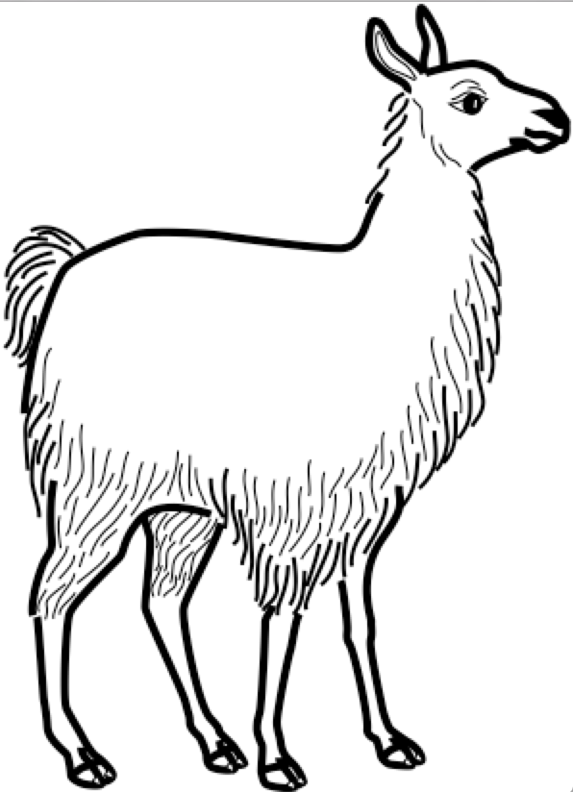
N-Gram Language Models – Two problems
Data sparsity: lack of generalization
What happens “one” n-gram never happens?
Inability to capture long-term dependencies
Each conditional only considers a small window of size n.
Consider “the same stump which had impaled the car of many a guest in the past thirty years and which he refused to have removed”
It is impossible to tell “removed” is likely by looking at the four preceding tokens.

Slide 55
Traditional Solutions
Data Sparsity
Smoothing: add a small constant to avoid 0.
Backoff: try a shorter window.
The most widely used approach: Kneser-Ney smoothing/backoff
KenLM implements the efficient n-gram LM model.

Slide 56
Traditional Solutions
Long-Term Dependency
Increase n: not feasible as the data sparsity worsens.
# of all possible n-grams grows exponentially w.r.t. n:
The data size does not grow exponentially: many never-occurring n-grams.
These two problems are closely related and cannot be tackled well.
To capture long-term dependencies, n must be large.
To address data sparsity, n must be small.
Conflicting goals..

Slide 57
N-Gram Language Models – Two problems
Data sparsity: lack of generalization
What happens “one” n-gram never happens?
Inability to capture long-term dependencies
Each conditional only considers a small window of size n.
Consider “the same stump which had impaled the car of many a guest in the past thirty years and which he refused to have removed”
It is impossible to tell “removed” is likely by looking at the four preceding tokens.

Slide 58
Neural N-Gram Language Model [Bengio et al., 2001]
The first extension of n-gram language models using a neural network
Table Lookup
Table Lookup
Softmax
Sentence
Representation
Extractor*
An arbitrary
sub-graph
Concatenation
Table Lookup

Slide 59
Neural N-Gram Language Model
The first neural language models
Trained using backpropagation and SGD
Generalizes to an unseen n-gram
Addresses the issue of data sparsity
How?
Table Lookup
Table Lookup
Softmax
Sentence
Representation
Extractor*
An arbitrary
sub-graph
Concatenation
Table Lookup

Slide 60
Neural N-Gram Language Model
Why does the data sparsity happen?
A “shallow” answer: some n-grams do not occur in the training data, while they do in the test time.
A “slightly deeper” answer: it is difficult to impose token/phrase similarities in the discrete space.
Table Lookup
Table Lookup
Softmax
Sentence
Representation
Extractor*
An arbitrary
sub-graph
Concatenation
Table Lookup

Slide 61
Neural N-Gram Language Model
Why does the data sparsity happen?
Back to the earlier example
Problem:
Observation:
If the LM knew “llama” is a mammal similar to “cat”, “dog” and “deer”, it would be able to guess ”chasing a llama” is as likely as “chasing a cat”, “chasing a dog”, and “chasing a deer”.
Table Lookup
Table Lookup
Softmax
Sentence
Representation
Extractor*
An arbitrary
sub-graph
Concatenation
Table Lookup

Slide 62
Neural N-Gram Language Model
The neural n-gram language model addresses this issue by “learning the similarities” among tokens and phrases in a “continuous vector space”.
In the “continuous vector space”, similar tokens/phrases are nearby: e.g., word2vec [Mikolov et al., 2013; Pennington et al., 2014], doc2vec [Le&Mikolove, 2014], sentence- to-vec [Hill et al., 2016 and ref’s therein]
Then, similar input n-grams lead to similar output:
Table Lookup
Table Lookup
Softmax
Sentence
Representation
Extractor*
An arbitrary
sub-graph
Concatenation
Table Lookup

Slide 63
Neural N-Gram Language Model
Training examples
there are three teams left for qualification.
four teams have passed the first round.
four groups are playing in the field.
Q: how likely is “groups” followed by “three”?
Table Lookup
Table Lookup
Softmax
Sentence
Representation
Extractor*
An arbitrary
sub-graph
Concatenation
Table Lookup
Continuous vector space
three
teams
four
groups

Slide 64
Neural N-Gram Language Model
In practice,
Collect all n-grams from the corpus.
Shuffle all the n-grams to build a training set
Train the neural n-gram language model using stochastic gradient descent on minibatches containing 100-1000 n-grams.
Early-stop based on the validation set.
Report perplexity on the test set.
Table Lookup
Table Lookup
Softmax
Sentence
Representation
Extractor*
An arbitrary
sub-graph
Concatenation
Table Lookup

Slide 65
Infinite context n→∞ – CBoW Language Models
Equivalent to the neural LM after replacing “concat” with “average”
“Averaging” allows the model to consider the infinite large context window.
Extremely efficient, but a weak language model
Ignores the order of the tokens in the context windows.
Any language with a fixed order cannot be modelled well.
Averaging ignores the absolute counts, which may be important:
If the context window is larger, “verb” becomes less likely in SVO languages.

Slide 66
Infinite context n→∞ – Recurrent Language Models [Mikolov et al., 2010]
A recurrent network summarizes all the tokens so far.
Use the recurrent network’s memory to predict the next token.
Efficient online processing of a streaming text:
Constant time per step.
Constant memory throughout forward computation
Useful in practice:
Useful for autocomplete and keyword suggestion.
Scoring partial hypotheses in generation.
Softmax
RNN
RNN
RNN

Slide 67
Infinite context n→∞ – Recurrent Memory Networks [Tran et al., 2016]
The recurrent network solves a difficult problem: compress the entire context into a fixed-size memory vector.
Self-attention does not require such compression but still can capture long-term dependencies.
Combine these two: a recurrent memory network (RMN) [Tran et al., 2016]
RNMT+: a similar, recent extension for neural machine translation
Softmax
Weighting
Function
Summation
RN
RNN
RNN
RNN
RNN
RNN
RNN
RNN
RNN
RNN
RNN
RNN

Slide 68
In this lecture, we learned
What autoregressive language modelling is:
How autoregressive language modelling transforms unsupervised learning into a series of supervised learning:
It is a series of predicting the next token given previous tokens.
How neural language modelling improves upon n-gram language models:
Continuous vector space facilitates generalization to unseen n-grams.
Infinitely large context window
How sentence representation extraction is used for language modelling:
Convolutional language models, recurrent language models and self-attention language models..

